Slide 1

Life Expectancy Prediction
OPIM 5604
Priyanka Garg
Rakesh Moparthi
Sowjanya Deepika Mutyala

Slide 2
Introduction
Data Overview:
The dataset comprises factors influencing life expectancy across 193 countries from 2000 to 2015.
Factors include immunization coverage, mortality rates, economic indicators, social factors, and other health-related variables.
Business Value:
Crucial for policymakers, healthcare providers, and governments.
Guides targeted policies, resource allocation, and interventions to improve population health outcomes.
Speaker: Rakesh Moparthi

Slide 3
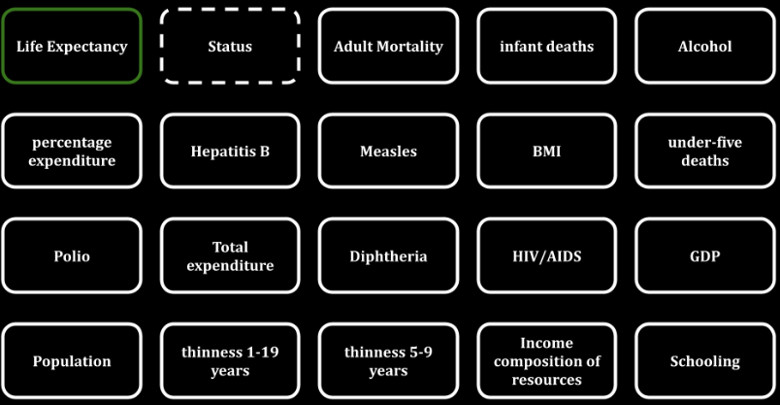
Variables/Columns
Speaker: Rakesh Moparthi

Slide 4
Business Problems
Which variables have the strongest impact on life expectancy?
Should countries with low life expectancy (<65) increase healthcare expenditure to improve average lifespan?
How do mortality rates, including infant and adult mortality, influence life expectancy?
Is there a correlation between lifestyle factors (diet, exercise, smoking, alcohol consumption) and life expectancy?
What is the relationship between education (schooling) and life expectancy?
Does Life Expectancy have a positive or negative relationship with drinking alcohol?
Do densely populated countries (Population) tend to have lower life expectancy?
What is the impact of immunization coverage ( Hepatitis B, Polio, Diphtheria) on life expectancy?
Speaker: Rakesh Moparthi

Slide 5
Data Exploration

Slide 6
Exploring Columns
Country: Names of 193 Countries - Exclude
Year: Years from 2000 to 2015 - Exclude
Status: Developing (0)
Developed (1)
Speaker: Rakesh Moparthi

Slide 7
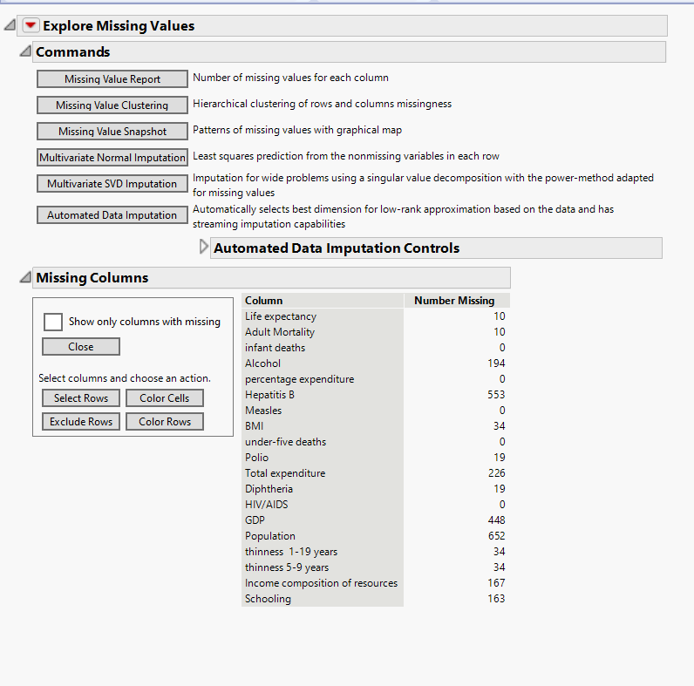
Exploring Missing values
Speaker: Rakesh Moparthi

Slide 8
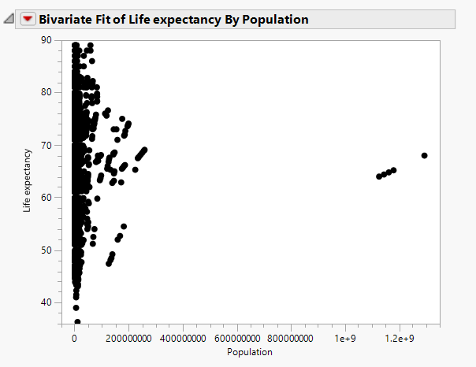
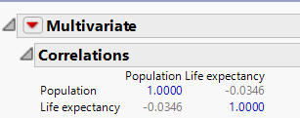
Population and Life Expectancy
We excluded Population as it has very very little correlation and has no impact on our target variable.
Speaker: Rakesh Moparthi

Slide 9
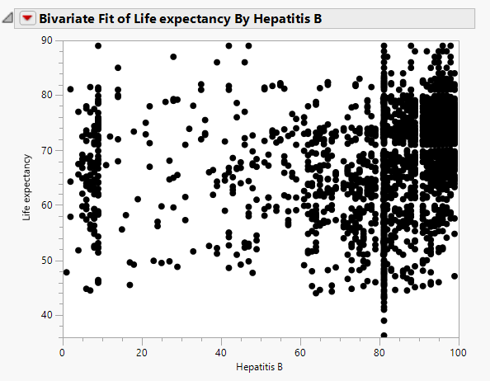
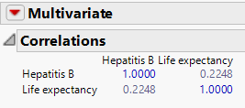
Hepatitis B and Life Expectancy
Imputation to address missing rows for Hepatitis B.
Speaker: Rakesh Moparthi

Slide 10
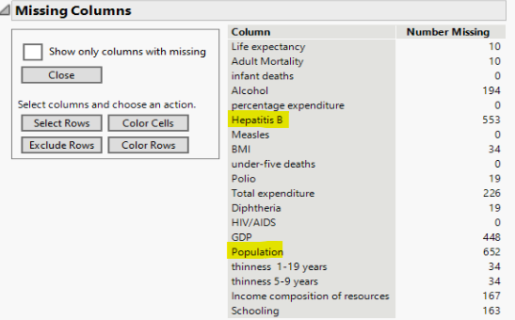
Handling Missing Values of other Columns
Columns other than Hepatitis B and Population have a fewer number of rows missing. Hence, we have excluded the missing rows for those columns.
Speaker: Rakesh Moparthi

Slide 11
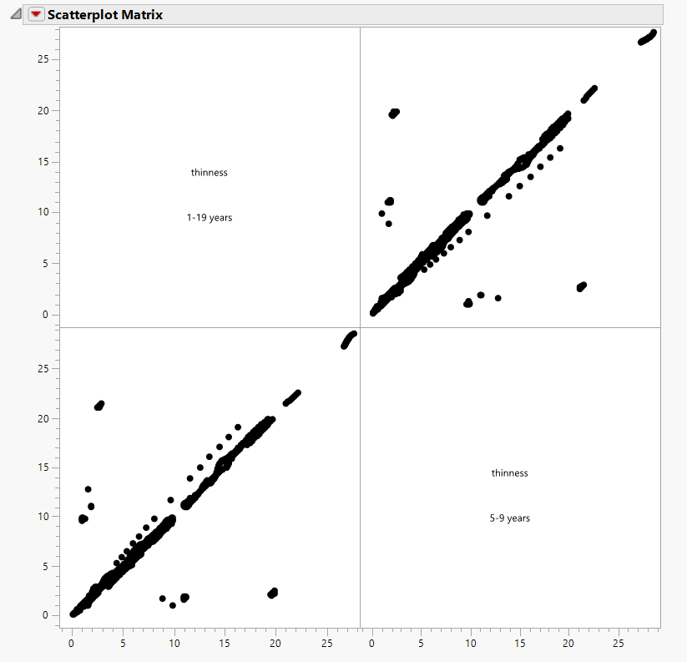
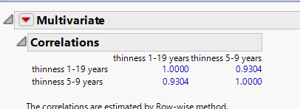
Correlation Between Thinness 1-19 years and Thinness 5-9 years
We excluded ‘Thinness 5 - 9 years’ as its positively correlated with Thinness 1-19 years.
Speaker: Rakesh Moparthi

Slide 12
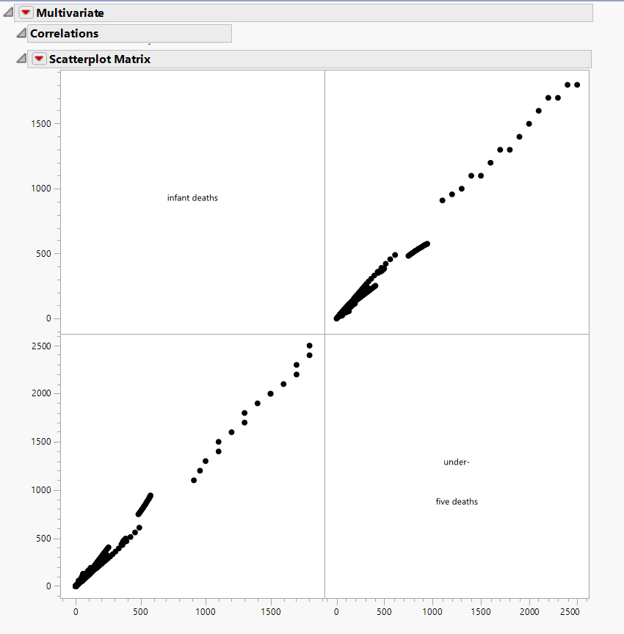
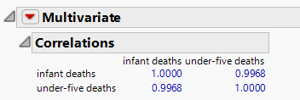
Correlation Between Infant Deaths and Under Five Deaths
We excluded ‘infant deaths’ as it is positively correlated with under-five deaths.
Speaker: Rakesh Moparthi

Slide 13
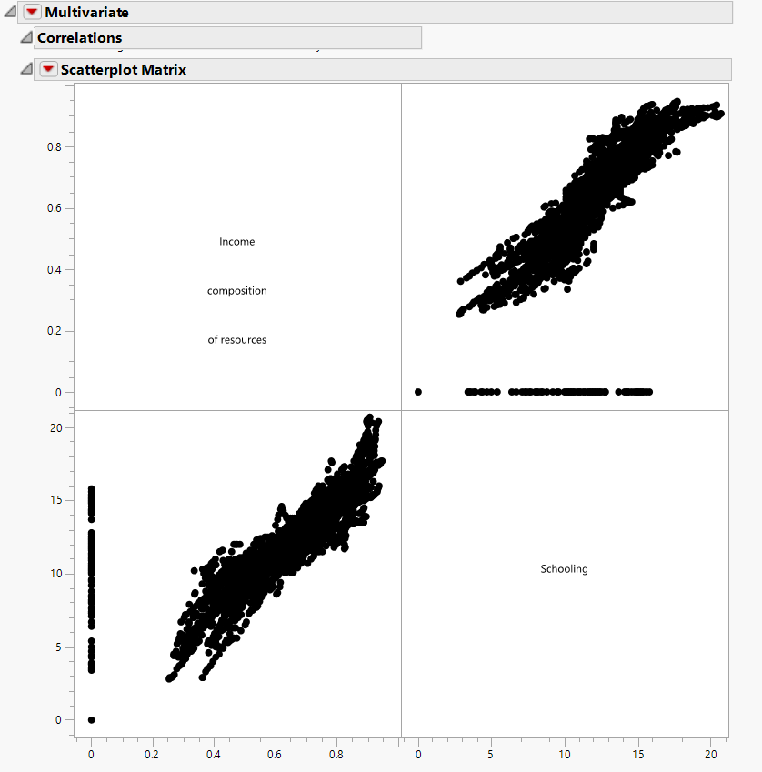
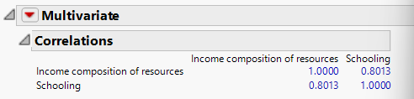
Correlation Between Income Composition and Schooling
We excluded ‘Income composition of resources’ as it is positively correlated with Schooling.
Speaker: Rakesh Moparthi

Slide 14
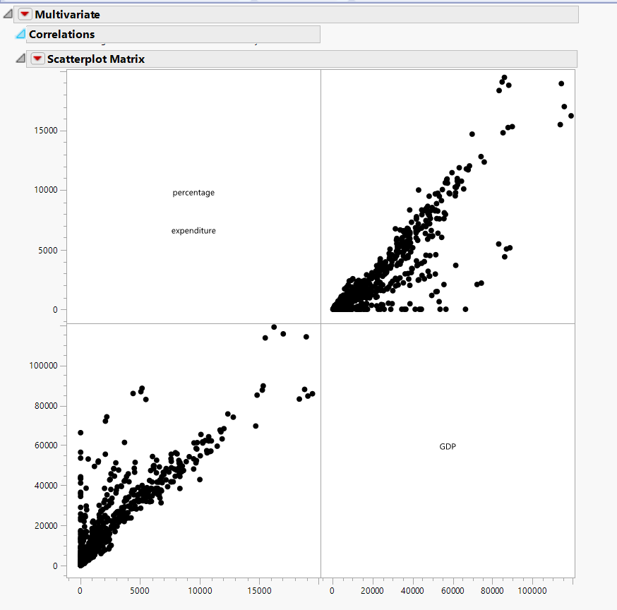
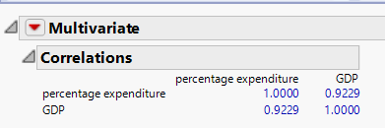
Correlation Between Percentage Expenditure and GDP
We excluded ‘Percentage Expenditure’ from our analysis as GDP seems to be an important variable.
Speaker: Rakesh Moparthi

Slide 15
Predictor Variables After Data Cleaning
Status
Adult Mortality
under-five deaths
Alcohol
Imputed_Hepatitis B
Polio
Diphtheria
Schooling
Measles
HIV/AIDS
Total expenditure
BMI
GDP
thinness 1-19 years
We are now left with 14 predictor columns out of which one column is categorical (status) and 1 target variable.
Speaker: Rakesh Moparthi

Slide 16
Predictive Models
Regression Analysis
Boosted Tree
Bootstrap Forest
Neural Network
KNN
Ensemble Models
Average of all Models.
Average of Neural and KNN.
Average of Neural and Bootstrap Forest.
Speaker: Sowjanya Deepika

Slide 17
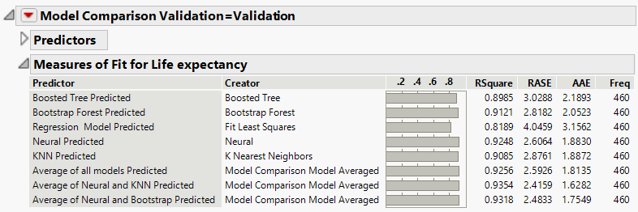
Model Comparison
Our Ensemble model between Neural and KNN Model is the best model.
Speaker: Sowjanya Deepika

Slide 18
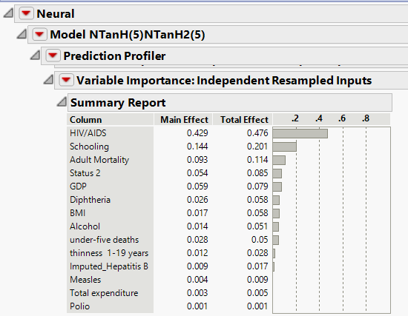
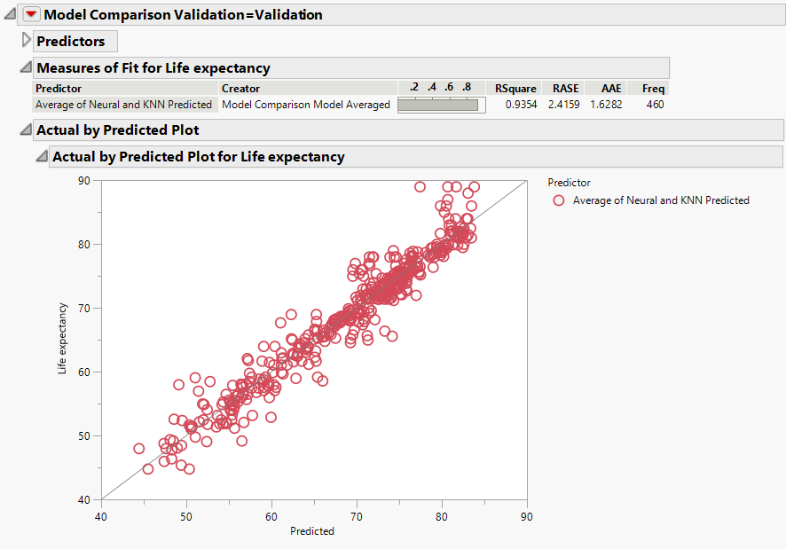
Best Model
Ensemble Model Average of Neural and KNN
Speaker: Sowjanya Deepika

Slide 19
Actual vs Predicted Plot
Speaker: Sowjanya Deepika

Slide 20
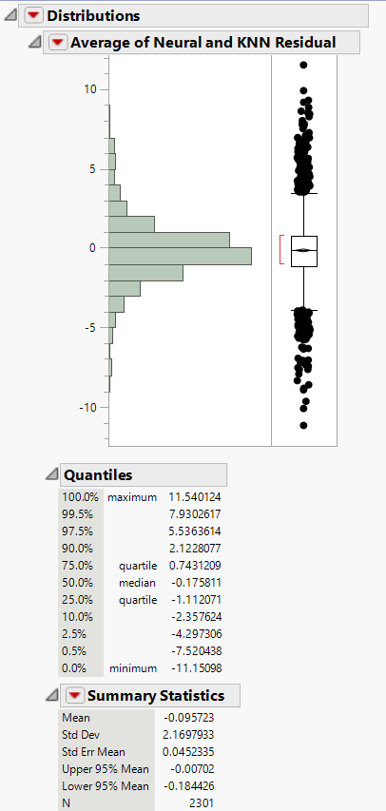
Residual Distribution
Speaker: Sowjanya Deepika

Slide 21
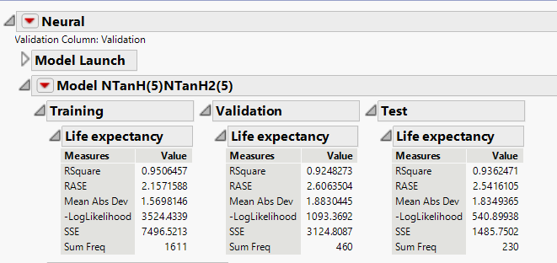
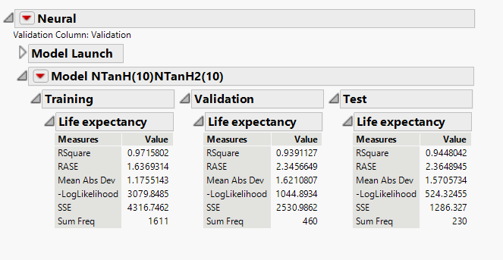
Trade-offs between Complexity and Accuracy
Speaker: Sowjanya Deepika

Slide 22

Business Findings
Which variables have the strongest impact on life expectancy?
HIV/AIDS
Schooling
Adult Mortality
Status
GDP
Speaker: Priyanka Garg

Slide 23
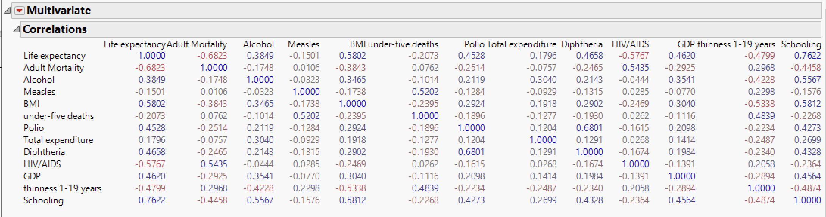
Business Findings
What is the relationship between education (schooling) and life expectancy?
Education is the second most important factor in our model, and it's positively linked to life expectancy.
Speaker: Priyanka Garg

Slide 24
Business Findings
Should countries with low life expectancy (<65) increase healthcare expenditure to improve average lifespan?
Increasing healthcare expenditure may not be the most effective solution for countries with low life expectancy (<65).
Speaker: Priyanka Garg

Slide 25
Business Findings
How do mortality rates, including infant and adult mortality, influence life expectancy?
Adult mortality appears to be the key factor influencing life expectancy in our analysis.
Speaker: Priyanka Garg

Slide 26
Business Findings
Is there a correlation between lifestyle factors (diet, exercise, smoking, alcohol consumption) and life expectancy?
Alcohol doesn’t seem to be a very important variable from our analysis.
Alcohol consumption shows a weak positive relationship with life expectancy.
Speaker: Priyanka Garg

Slide 27
Business Findings
Do densely populated countries (Population) tend to have lower life expectancy?
Densely populated countries don't necessarily have lower life expectancy. We excluded the population column due to its minimal impact and maximum missing data.
Speaker: Priyanka Garg

Slide 28
Business Findings
What is the impact of immunization coverage ( Hepatitis B, Polio, Diphtheria) on life expectancy?
Immunization coverage for diseases like Diphtheria and Hepatitis B significantly affects life expectancy.
Speaker: Priyanka Garg

Slide 29
Recommendations
Prioritize HIV/AIDS: Focus on HIV/AIDS prevention, testing, treatment, and support services for improved life expectancy.
Invest in Education: Promote education to boost population health and increase life expectancy.
Reduce Adult Mortality: Implement interventions for healthcare access, chronic disease detection, and healthy lifestyles to lower mortality rates.
Strengthen Vaccination Programs: Enhance vaccination efforts for diseases like Diphtheria and Hepatitis B to improve public health and life expectancy.
Speaker: Priyanka Garg

Slide 30
References
https://www.kaggle.com/datasets/kumarajarshi/life-expectancy-who
Shmueli, G. (2023). Machine Learning for Business Analytics: Concepts, Techniques, and Applications with JMP Pro 2nd Edition. Hoboken, NJ: Wiley.

Slide 31
APPENDIX

Slide 32
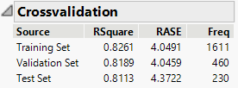
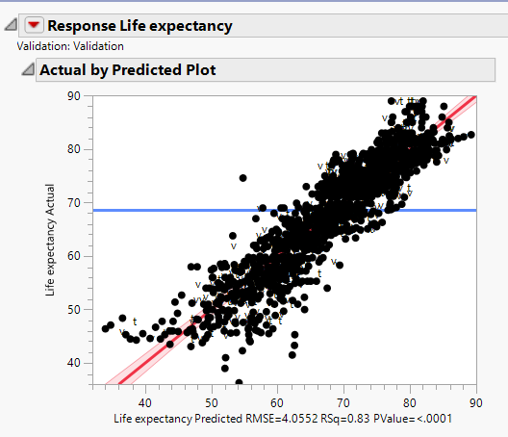
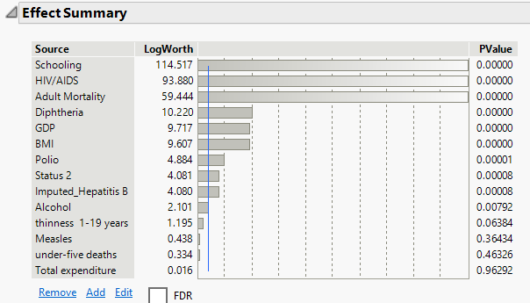
Regression Model

Slide 33
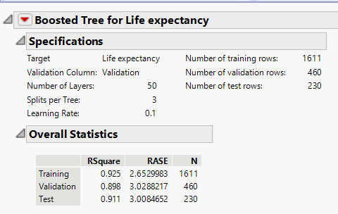
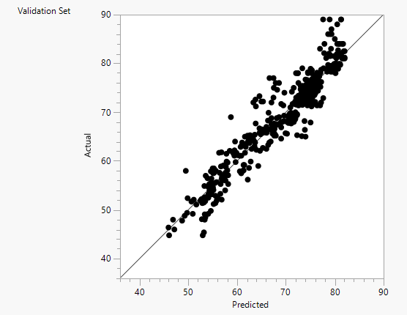
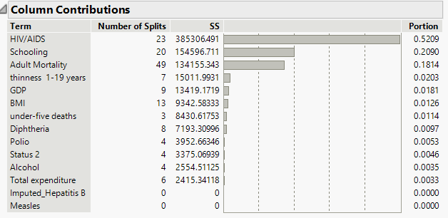
Boosted Tree Model

Slide 34
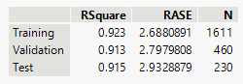
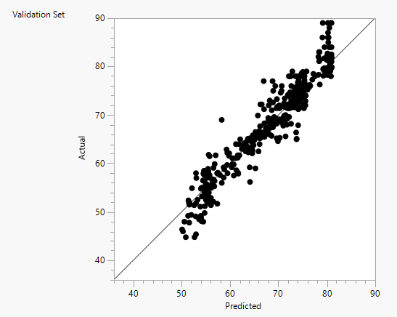
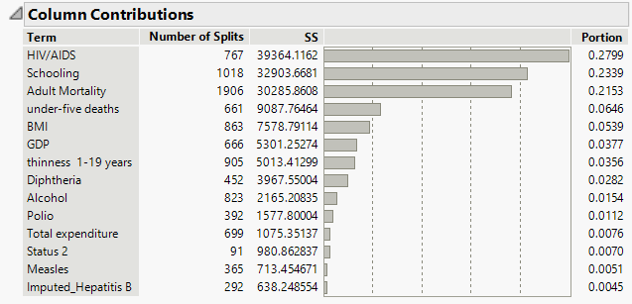
Bootstrap Forest Model

Slide 35
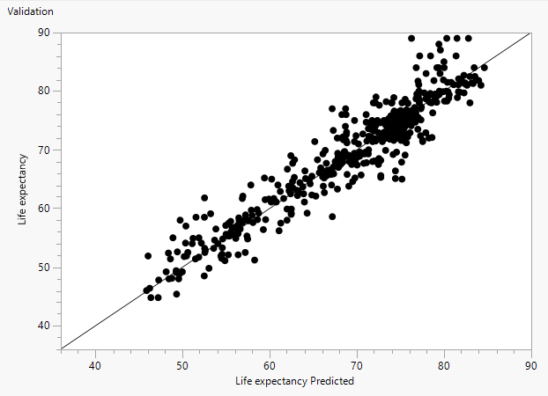
Neural Network Model

Slide 36
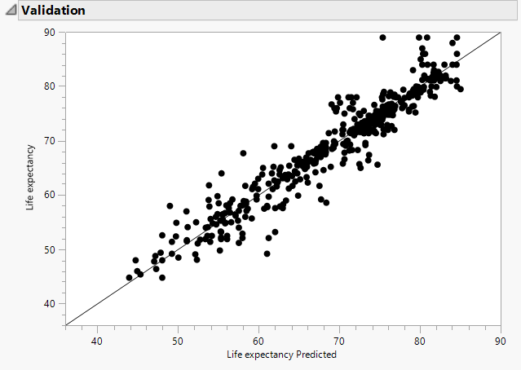
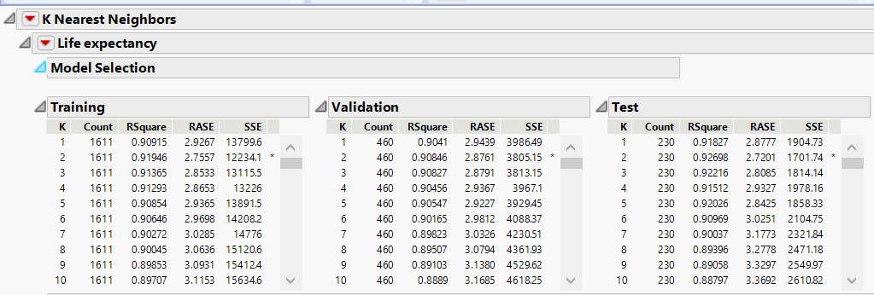
KNN Model

Slide 37
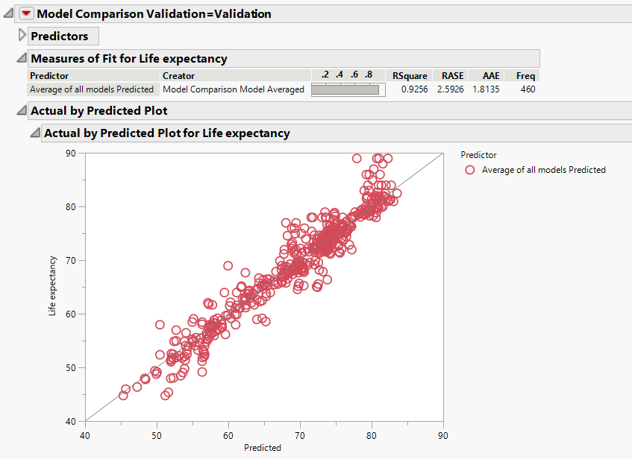
Ensemble Model – Average of ALL Standard models

Slide 38
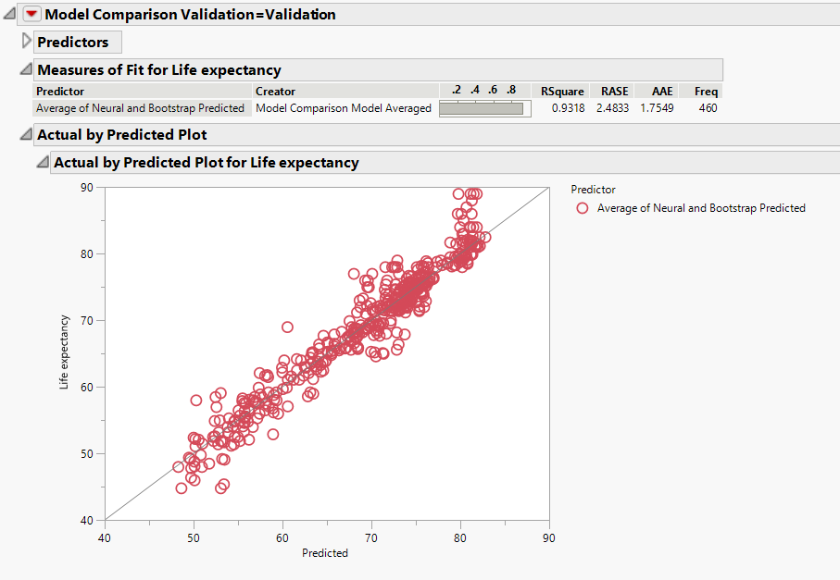
Ensemble Model – Average of Neural and Bootstrap Forest

